Slide 2
Man-in-the-middle Attacks

Slide 3

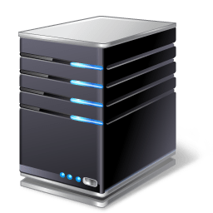
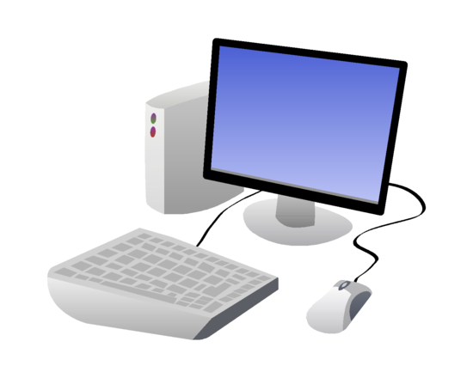


Man-in-the-middle
Authorized user
Server
Clear text
Capture traffic
Sniffing Traffic
Store captured traffic

Slide 4
Man-in-the-middle
Server
Replay captured traffic

Slide 5
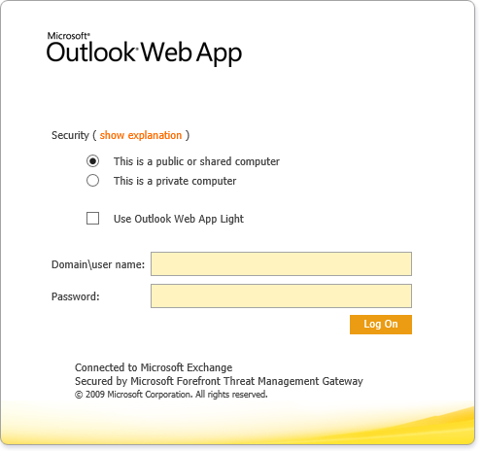





Man-in-the-browser Attack
Change password
User logs in

